Slide 1
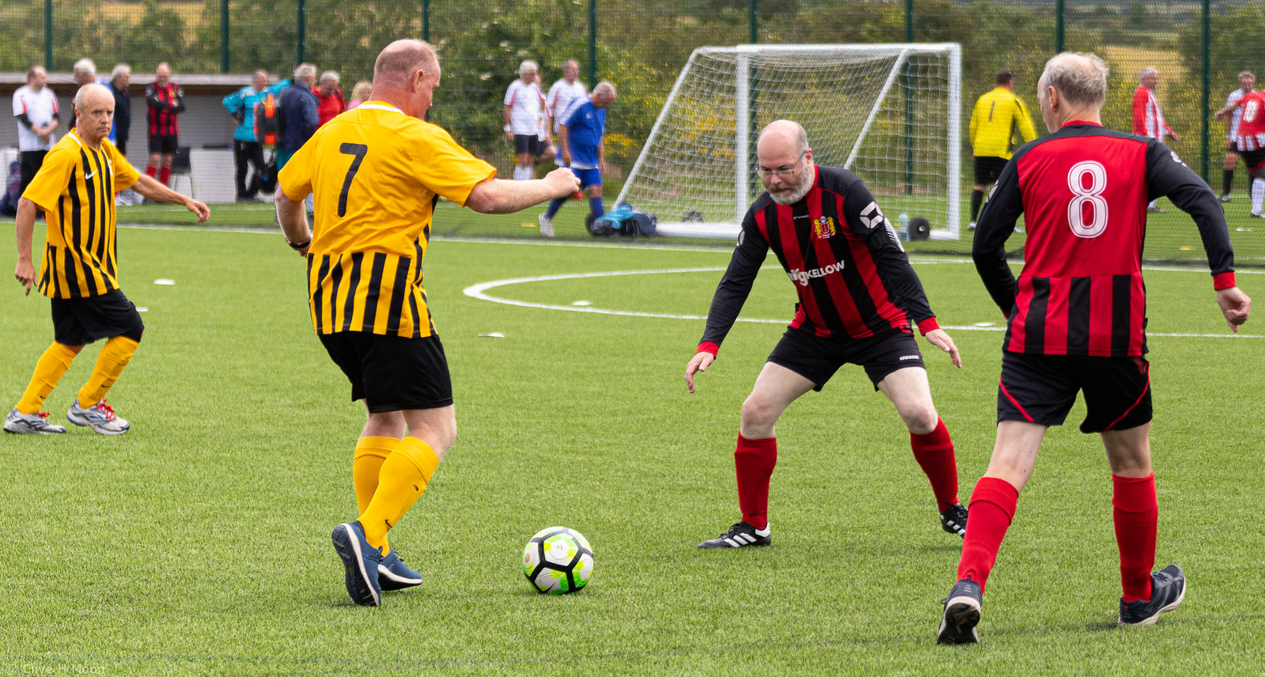

Walking Football Steering Group Meeting
21/02/2022

Slide 2
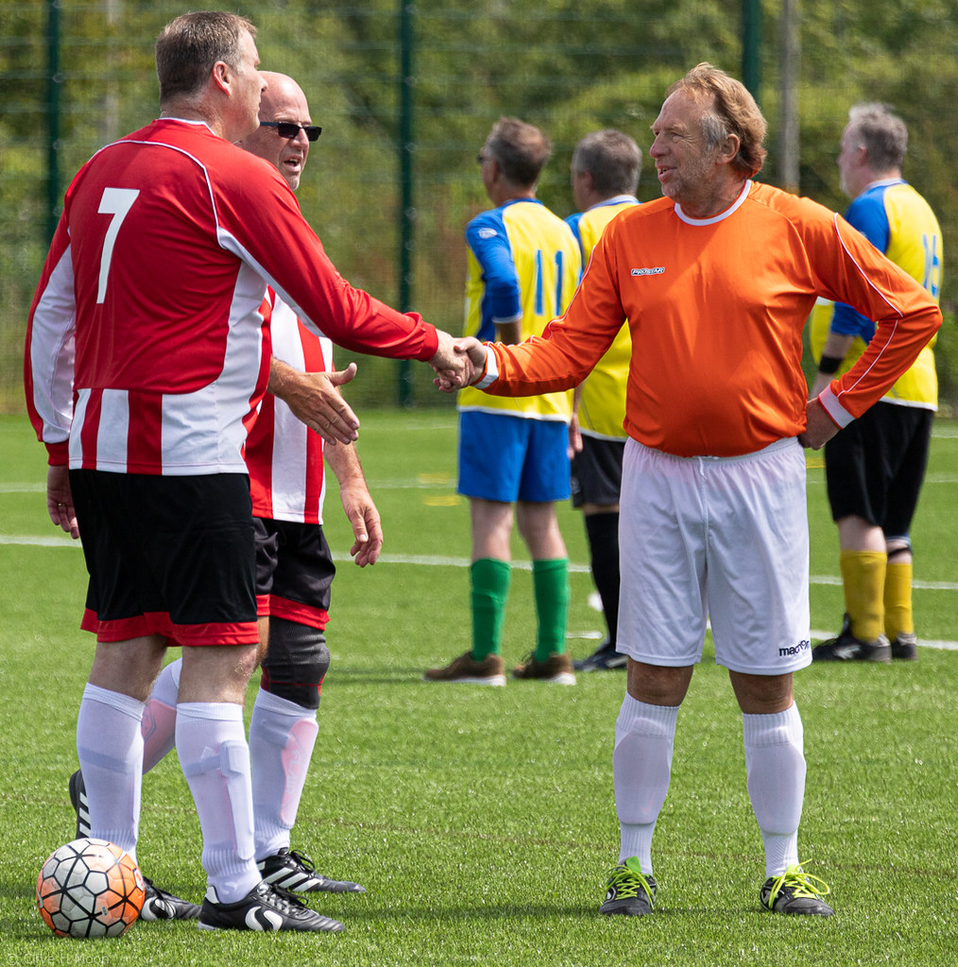
League/Committee Sanction
Current Officials:
Chairperson – Barry Cornelius
Secretary – Kevin Solly
Treasurer – To be appointed
Referee Officer – Keith Butler
Rules Officer- To be appointed
Other members – Steve Bailey , Peter Harlow
Other roles - ?

Slide 3
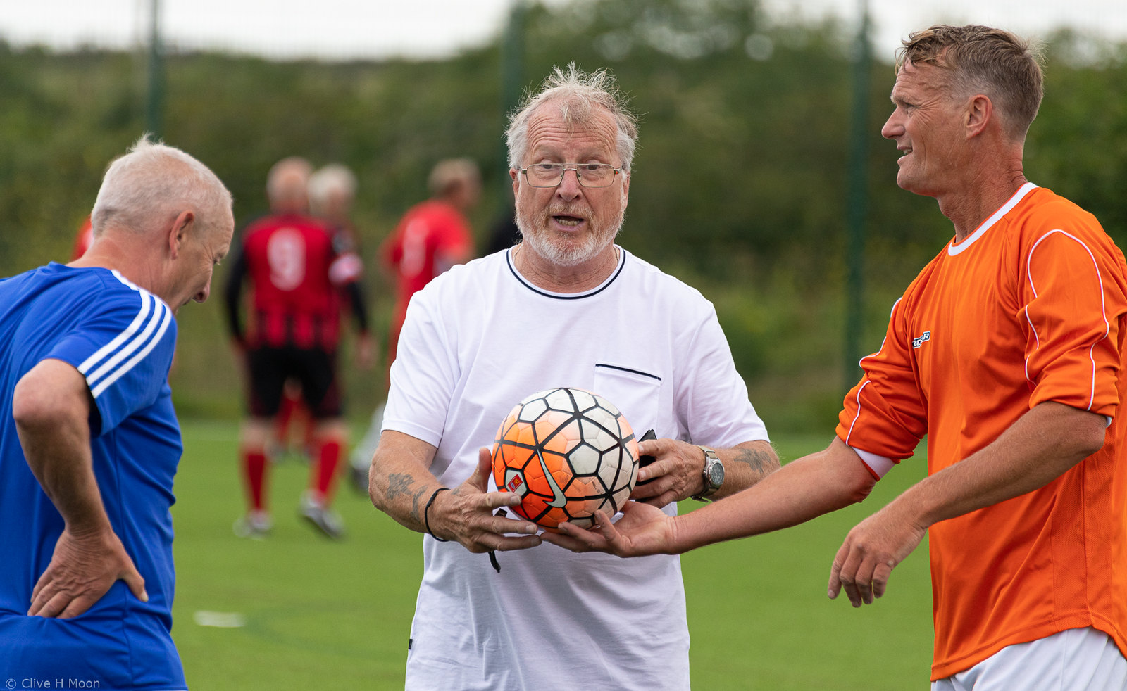




League/Committee Sanction
Bank Account
In Progress
First League Sponsor Age UK Cornwall and Isles of Scilly
Constitution/Rules Richard Pallot creating
Teams can now be added to the league sanction when ready.

Slide 4
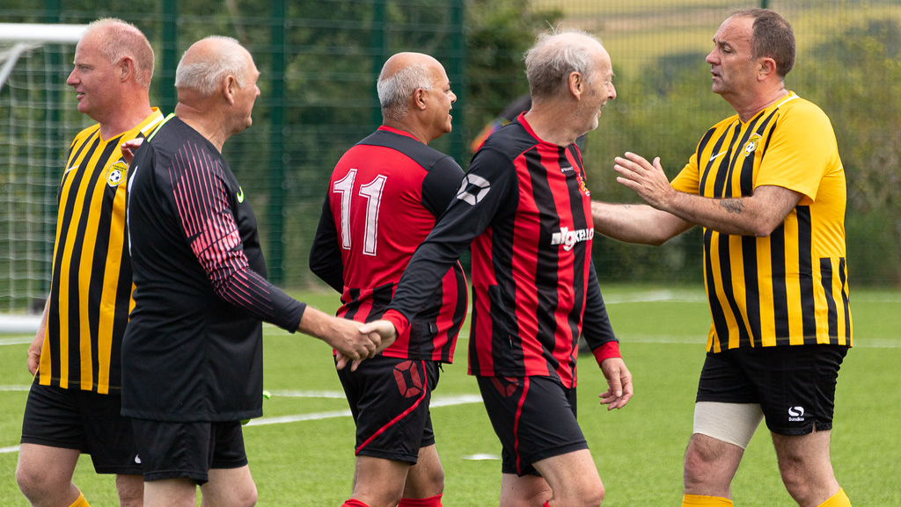
2022 Season of Events
Feb/March | April | May | June | July
Referee Workshops / Friendlies | Relaunch Festival and/or Friendlies | Troon (1/5) possibly June | League round (TBC) and Open Events | Troon (17/7), League Round 2 (TBC)
August | September | October | November | December
League Round 3 (TBC) | League Finals (TBC) | ? | Cornwall FA Winter Festival

Slide 5
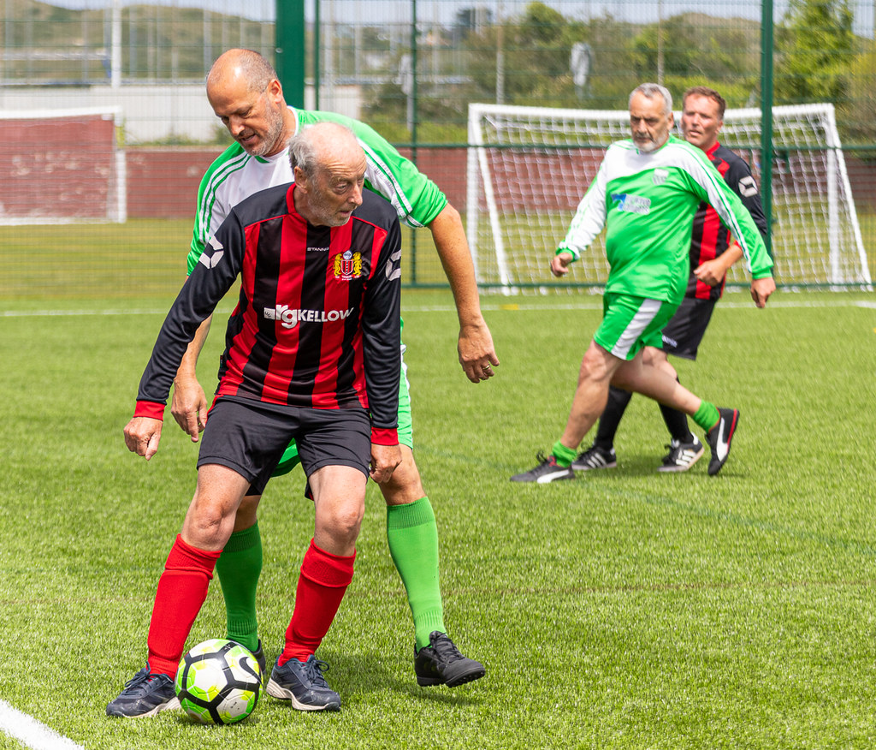
2022 Season of Events
Other Clubs/Teams?
Charity Cup?
Cross county competition with Devon FA and their teams.

Slide 6
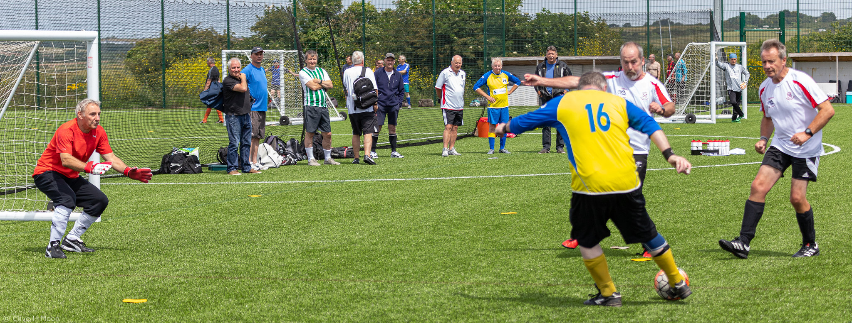
Summer League
Played on an East and West basis over 3 days in June, July and August with a central final in September – format yet to be decided

Slide 7


What is it?
On Pitch
Off pitch
Application through your club portal (Training Available).

Slide 8

On Pitch
1
Minimum Qualified First Aider at all training/fixtures

Slide 9
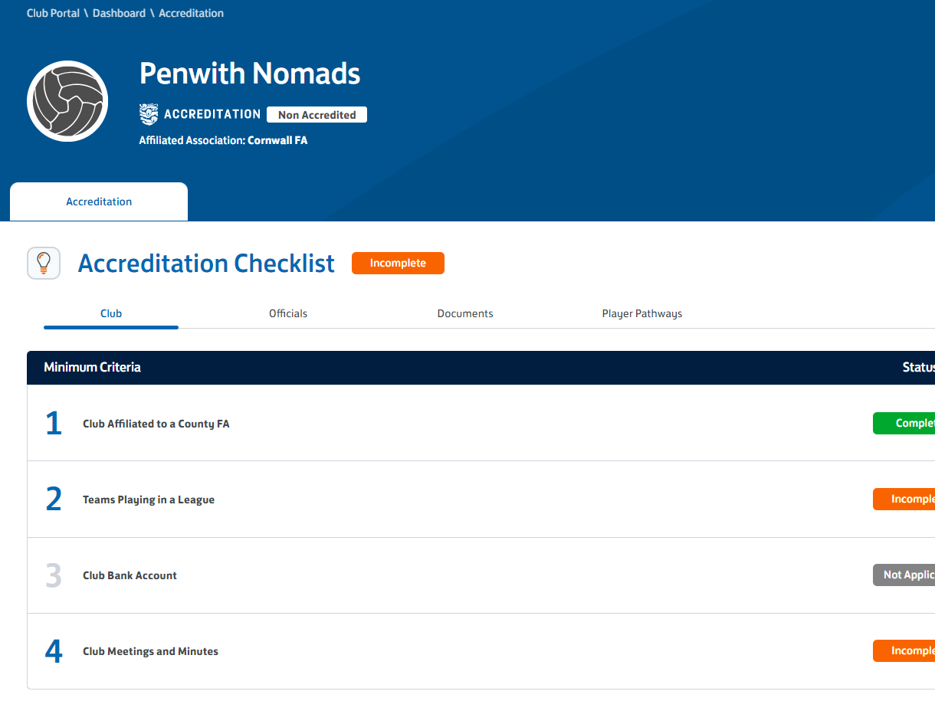
Off Pitch
Submit evidence on Club Portal
Committee Meeting Minutes
AGM Minutes
Copy Of Annual Accounts (two or more affiliated teams)
Qualified First Aider correctly added to your team

Slide 10
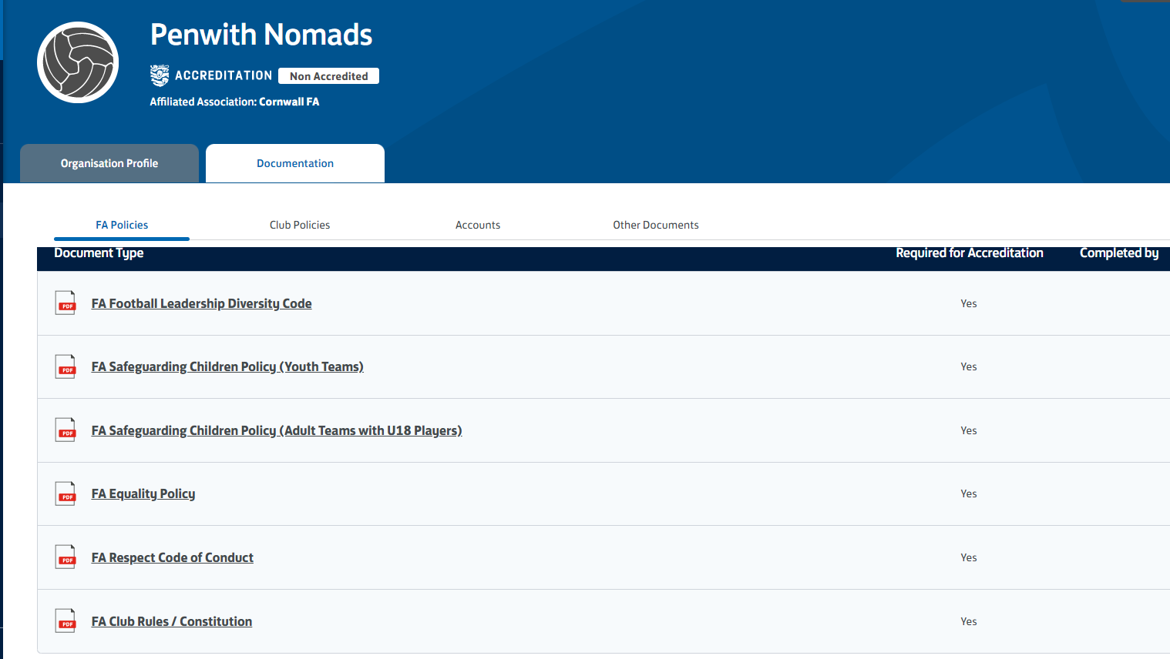
Documentation

Slide 11

Benefits:
Footballs
Kit Voucher
Plaque
Social Media, Website etc., Asset Pack
League Accreditation to follow.

Slide 12
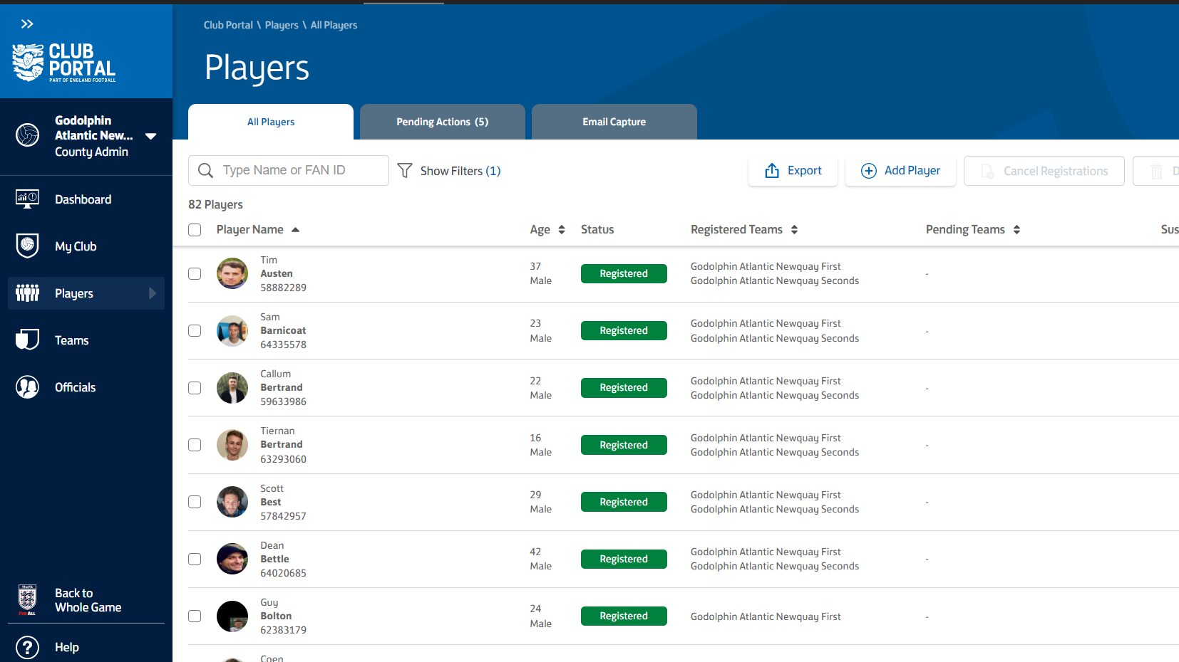
Player Registration Portal

